Slide 1
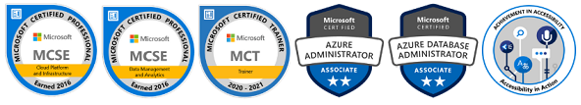
Introduction to the Azure SQL Family
John Deardurff
Customer Engineer (Global Technical Team)
Microsoft Certified Trainer (Regional Lead)
Twitter: @SQLMCT
https://www.SQLMCT.com
Notes:
This is intended for SQL Server people. But if you’re not a SQL Server person, still a good way to get a general understanding of security for Azure SQL.

Slide 2
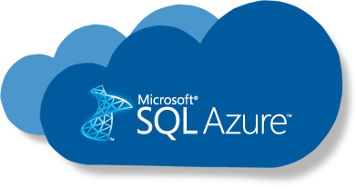
Today’s Agenda
Azure SQL Overview
SQL Server on Azure VMs
Azure SQL Managed Instance
Azure SQL Database
Serverless and Elastic Pools
Comparison and summary

Slide 3
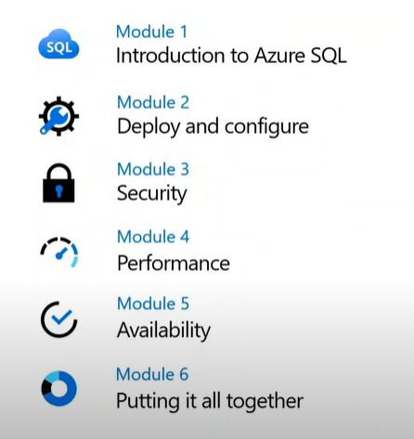
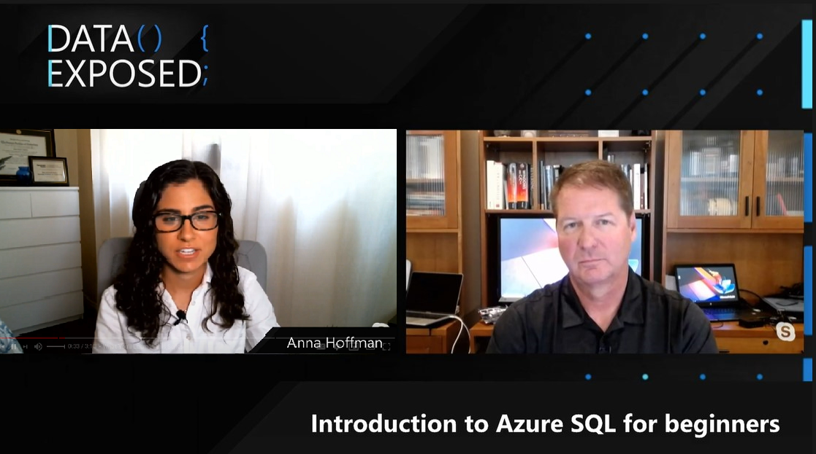
Azure SQL for Beginners
aka.ms/azureSQLfundamentals
aka.ms/sqlWorkshops

Slide 4

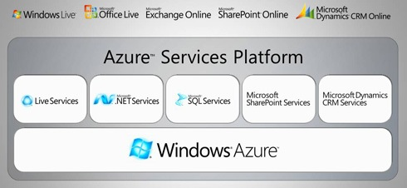
History of Azure SQL
Ray Ozzie – Chief Software Architect (PDC 2008)
Overview
SQL Server on Azure VMs
Azure SQL MI
Azure SQL Database
Comparison and summary
Notes:
Before we talk about Azure SQL and what to use when, let's briefly consider where it started. In 2008, at the Microsoft Professional Developers Conference, Microsoft's Chief Software Architect (at the time) Ray Ozzie announced the new cloud computing operating system, Windows Azure (or "Project Red Dog"), which was later changed to Microsoft Azure. One of the five key components of the Azure Services Platform launch was "Microsoft SQL Services." From the beginning, SQL has been a big part of Azure.
An explanation of when you would want to use the early Azure SQL Database (2010) is as follows: [Azure SQL Database] is a cloud database offering that Microsoft provides as part of the Azure cloud computing platform. Unlike other editions of SQL Server, you do not need to provision hardware for, install or patch [Azure SQL Database]; Microsoft maintains the platform for you. You also do not need to architect a database installation for scalability, high availability or disaster recovery as these features are provided automatically by the service. Any application that uses [Azure SQL Database] must have Internet access in order to connect to the database.
This explanation still remains valid today, though the capabilities around security, performance, availability, and scale have been enhanced greatly.

Slide 5
Azure SQL has come a long way
2006
2010
2013
2015
2018
2020
CloudDB
RedDog
Windows Azure and SQL Azure launch
Azure
Virtual Machines
Azure SQL Database V12
Azure SQL Database Managed Instance
Azure SQL
Family
Windows Azure and SQL Data Services announced
SQL Azure →
Azure SQL Database
Windows Azure → Microsoft Azure
Azure SQL Database Elastic Pools
Azure SQL Database Hyperscale
Azure SQL Database Serverless
Azure SQL Instance Pools
2008
2012
2014
2016
2019
Overview
SQL Server on Azure VMs
Azure SQL MI
Azure SQL Database
Comparison and summary
Notes:
Azure SQL has evolved over the years to include Virtual Machine, Managed Instances, and several options for Databases. There are now multiple deployment options with the flexibility to scale to your needs, and there have been over seven million deployments of some form of Azure SQL. The architecture for Azure SQL has also evolved to meet the ever growing demands of applications. E.g. elastic databases, vCore choices, Business Critical deployments, Hyperscale, and Serverless architectures.
Since 2008, SQL Server has changed a lot and Azure SQL has changed a lot. It's no surprise then that the role of the SQL Server professional has also changed a lot and today I want to help you become an Azure SQL professional.
2006
CloudDB Project
RedDog Project
2008
Windows Azure and SQL Data Services announced at PDC
2010
Windows Azure and SQL Azure officially launch.
2012
SQL Azure branded Azure SQL Database
2013
Azure Virtual Machines released
2014
Windows Azure branded Microsoft Azure
2015
Azure SQL Database V12 released
2016
Azure SQL Database Elastic Pools released
2018
Azure SQL Database Managed Instance released
2019
Azure SQL Database Hyperscale Released
Azure SQL Database Serverless Released

Slide 6
Savings opportunity for modernizing your data estate is significant
Managed by customer
Managed by Microsoft
Machine-learning capability
Platform
(as a Service)
On-premises
Infrastructure
(as a Service)
On-premises costs tend to be driven by hardware and data center management costs
Infrastructure-as-a-Service reduces cost categories related to data center and compute
Platform-as-a-Service off-loads customers’ most administrative tasks to Azure, further improving efficiency with machine-learning capabilities for performance and security
Managed Instance: instance-level deployment for lift-shift existing apps to Azure, fully backward compatible
Single database: database-level deployment for new apps
Intelligent performance/security
Applications
Applications
Applications
Data
Data
Data
High availability /DR/Backups
High availability /DR/Backups
High Availability/ DR/Backups
Database Provision/ Patch/Scaling
Database Provision/ Patch/Scaling
Database Provision/ Patch/Scaling
O/S provision /patching
O/S
O/S
Virtualization
Virtualization
Virtualization
Hardware
Hardware
Hardware
Datacenter Management
Datacenter Management
Datacenter Management
SQL Server 2017/2019
Azure SQL VMs
Azure SQL Database
Notes:
Azure SQL Database is a fully-managed platform-as-a-service. This means Microsoft operates SQL Server for you, assuming much of the daily maintenance, administration and infrastructure costs of your IT organization.
Quickly realize spend and operational efficiencies you may not have otherwise experienced with your on-premises or hosted solution.
Along with ensured availability and performance, features of Azure SQL Database include:
Provisioning and resizing (w/ Azure Portal experience)
Built-in auto HA (99.99%)
Automatic backup
Point-in-time-restore (database-level)
Active geo-replication
Intelligent performance optimization and security of your databases

Slide 7


Azure SQL
A unified SQL portfolio built on the industry-leading SQL Server engine
SQL Server on Azure Virtual Machines
Azure SQL Managed Instance
Azure SQL Database
Best for re-hosting and apps requiring OS-level access and control
Automated manageability features and OS-level access
Best for modernizing existing apps
Offers high compatibility with SQL Server and native VNET support
Best for building new apps in the cloud
Pre-provisioned or serverless compute and Hyperscale storage to meet demanding workload requirements
Infrastructure as a Service
Platform as a Service
Overview
SQL Server on Azure VMs
Azure SQL MI
Azure SQL Database
Comparison and summary

Slide 8
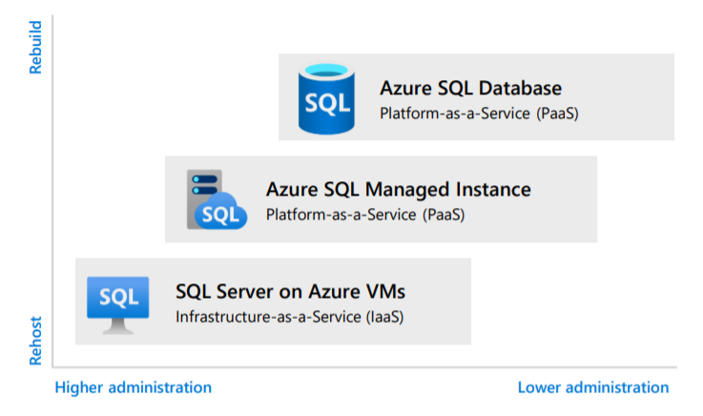
Cloud migration effort and administration
Azure SQL gives you cloud database options that meet your needs
Build modern cloud applications on intelligent, managed Azure SQL Database that includes serverless compute.
Modernize your existing SQL Server applications at scale on a fully managed Azure SQL Managed Instance.
Lift-and-shift your SQL workloads to SQL Server on Azure VMs with ease and maintain them with 100% SQL Server compatibility and operating system level access.
Overview
SQL Server on Azure VMs
Azure SQL MI
Azure SQL Database
Comparison and summary

Slide 9
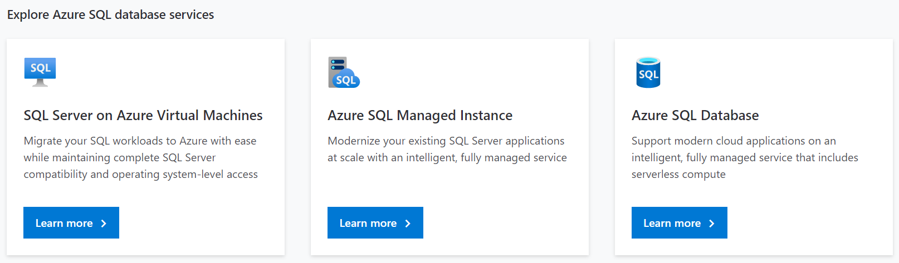
Azure SQL Family
Azure SQL Family is a consistent, unified experience across your entire SQL portfolio
https://aka.ms/AzureSQLfamily
Overview
SQL Server on Azure VMs
Azure SQL MI
Azure SQL Database
Comparison and summary

Slide 10

Azure SQL Family SQL Server on Azure Virtual Machines
Notes:
https://github.com/microsoft/sqlworkshops-azuresqlworkshop/blob/master/azuresqlworkshop/05-Availability/basic-ha/basic-ha.ipynb
Need to have a BC and GP database deployed in order to do side by side

Slide 11

SQL Server on Azure VMs provides the promise of the cloud while maintaining OS control
Key features
SQL Server and OS server access
Expansive SQL and OS versions
Windows, Linux, Containers
File stream, DTC, and Simple Recovery model
SSAS, SSRS, and SSIS
Azure differentiators
Free Extended Security Updates for SQL Server 2008/R2
Automated Backups and Security Updates
Point in Time Restore with Azure Backup
Accelerated storage performance with Azure Blob Caching
435 percent overall return on an Azure IaaS investment over five years¹
Customer challenge
I want to migrate to the cloud as fast as possible but maintain operating system control and complete SQL Server functionality
Solution
Get the combined performance, security, and analytics of SQL Server, backed by the flexibility, security, and hybrid connectivity of Azure
Healthcare software manufacturer saves costs when reusing licenses while moving 600 on-premises VMs to Azure
1. Forrester Consulting. The Total Economic Impact™ of Microsoft Azure SQL Database Managed Instance.
Overview
SQL Server on Azure VMs
Azure SQL MI
Azure SQL Database
Comparison and summary
Notes:
Best for migrations and applications requiring OS-level access
Challenges
The contract on my hardware is expiring
I have instances of SQL Server 2008 and 2008 R2
I want to migrate to the cloud as fast as possible
I use third party software that needs OS-level access
I have dependencies on SSRS
I want to extend our on-premises apps to Azure
I need an unlimited number of DBs
I want the full feature set of SQL Server 20XX
Solution
SQL Server and OS server access
Expansive SQL and OS version support
File stream, DTC, and Simple Recovery model available
Automated patching and backup
Free Extended Security Updates for SQL Server 2008/R2*
435 percent overall return on an Azure IaaS investment over five years (Forrester Consulting)
Up to 3.4x faster and 87% cheaper than AWS EC2**
Azure Key Vault integration
Support for Linux and Windows
Note: maybe only 1 here – the best one, rest in notes
Does your application require custom VM or SQL config? DB engine version choice, feature compatibility with SQL box, app portability, access to VM/OS
* ESU worth 75% of license every year for the next three years after EOS; ** Applicable to Azure Marketplace images, customers using customer SQL Server 2008/R2 custom images can download the ESU for free and manually apply.
VMs: Allscripts https://customers.microsoft.com/en-us/story/allscripts-partner-professional-services-azure
Move 600 VMs to Azure within a few weeks. Some time later moving some to MI
Rehost SQL Server 2008 and 2008 R2 in Azure Virtual Machines to get three years of Extended Security Updates at no additional charge and upgrade to a newer version when ready
435 percent overall return on an Azure IaaS investment over five years (for a composite organization based on the interviewed customers) (Forrester Consulting)
https://azure.microsoft.com/en-us/overview/azure-vs-aws/cost-savings/#sql-server-iaas

Slide 12
SQL Server on Azure Virtual Machines
Marketplace pre-installed SQL Server on Windows or Linux
Install your own SQL Server
Lift and Shift with Azure Migrate (Azure Site Recovery)
Deployment Choices
Unlock Licensing and Edition Flexibility
Automated Backups and Security Updates
Manage VMs through Azure SQL in portal
Resource Provider
Memory or Storage optimized sizes for best performance
Data and log on Premium Storage Managed Disks
Azure Blob Read Caching for data disks
Tempdb on local SSD
Ultra disks for extremely low latency needs
Sizes and Storage Performance
Networking and Security
Virtual Networks to integrate with on-premises
Advanced Data Security services (Preview)
Azure VM built-in HA
Azure Storage built-in DR
Azure Backup and Automated backups to Azure Blob Storage
File-Snapshot Backups
Failover Cluster Instance with Azure Premium File Share
Always On Availability Groups with Cloud Witness
Hybrid Availability Group Secondary replicas
HADR on RedHat Linux with Pacemaker and fencing
HADR
Overview
SQL Server on Azure VMs
Azure SQL MI
Azure SQL Database
Comparison and summary

Slide 13
Azure SQL Family Azure SQL Managed Instance
Notes:
https://github.com/microsoft/sqlworkshops-azuresqlworkshop/blob/master/azuresqlworkshop/05-Availability/basic-ha/basic-ha.ipynb
Need to have a BC and GP database deployed in order to do side by side

Slide 14

Azure SQL managed instance eases cloud migration
Key features
Single instance or instance pool
SQL Server surface area (vast majority)
Native virtual network support
Fully managed service
On-premise identities enabled with Azure AD and AD Connect
Azure differentiators
Near zero downtime migration using log shipping
Fully managed business continuity with failover groups
Projected return on investment of 212 percent over three years¹
The best of SQL Server with the benefits of a managed service
Customer challenge
I want to migrate to the cloud, remove management overhead, but I need instance-scoped features (Service Broker, SQL Server Agent, CLR…)
Solution
Managed instance combines leading security features with SQL Server compatibility and business model designed for on-premises customers
Komatsu easily migrated 1.5 TBs of data thanks to near complete compatibility with SQL Server, plus 49% cost reduction and 25-30% performance gains.
1. Forrester Consulting. The Total Economic Impact™ of Microsoft Azure SQL Database Managed Instance.
Overview
SQL Server on Azure VMs
Azure SQL MI
Azure SQL Database
Comparison and summary
Notes:
Best for most lift-and-shift migrations to the cloud
It is called an Instance because it is equivalent to a Database Engine Instance of SQL Server which we define actually in our docs at https://docs.microsoft.com/en-us/sql/database-engine/configure-windows/database-engine-instances-sql-server?view=sql-server-ver15. The term Database Engine Instance is important because other instance types for SQL Server are things like SSAS.
It's called Managed because it is a PaaS version of a Database Engine Instance where we manage several things including install of SQL Server, scaling, and high-availability.
Challenges
I want to migrate to Azure
I want to remove some of the management overhead and stress with regards to business continuity, high availability, and disaster recovery
I need instance-scoped features like SQL Server Agent, Database Mail, Service Broker, CLR, etc.
Solution
Single instance or Instance pool
SQL Server surface area (vast majority)
Native virtual network support
Fully managed Service
Enable your on-premise identities on cloud instances, through integration with Azure Active Directory and AD Connect
Near zero downtime migration using log-shipping
Fully managed business continuity with failover groups
Projected return on investment of 212 percent over three years (Forrester Consulting)
Combine the best of SQL Server with the benefits of a managed service
You get two levels of isolation:
Cluster level: Managed Instances for a tenant are fully isolated from other tenants. No connectivity or resource sharing is possible between different tenants.
Networking level: joining instances to a subnet in a VNET and restricting access to private IP addresses only provides full isolation from public Internet.
Managed Instance: Komatsu https://customers.microsoft.com/en-us/story/komatsu-australia-manufacturing-azure
Moved about 1.5 TBs of data very smoothly because of the near 100% compatibility with SQL Server
49% reduction in cost and 25% increase in performance gains

Slide 15
Service tiers – Managed Instance
General purpose
Business critical
Most business workloads
Workloads that require low latency, fast recovery, and a readable secondary
vCore model
Independent scalability
Remote storage
Local storage
IOPS
$
IOPS++
$$$
In-memory
P
P
S
S
R
Overview
SQL Server on Azure VMs
Azure SQL MI
Azure SQL Database
Comparison and summary
Notes:
Maybe add in vcore / storage

Slide 16
Azure SQL Family Azure SQL Database
Notes:
https://github.com/microsoft/sqlworkshops-azuresqlworkshop/blob/master/azuresqlworkshop/05-Availability/basic-ha/basic-ha.ipynb
Need to have a BC and GP database deployed in order to do side by side

Slide 17

Azure SQL Database is built for modern cloud apps
Key features
Single database or elastic pool
Hyperscale storage (100TB+)
Serverless compute
Fully managed service
Private link support
High availability with AZ isolation
Azure differentiators
Industry highest availability SLA of 99.995%
Industry only business continuity SLA with 5 second RPO and 30 second RTO
Price-performance leader for mission-critical workloads while costing up to 86 percent less than AWS RDS (GigaOm)
Customer challenge
I want to build modern apps, potentially multi-tenanted, with the highest uptime and predictable performance
Solution
Azure SQL Database is a highly scalable cloud database service with built-in high availability and machine learning
AccuWeather uses Azure SQL Database to provide an automated, scalable weather prediction service
1. Forrester Consulting. The Total Economic Impact™ of Microsoft Azure SQL Database Managed Instance.
Overview
SQL Server on Azure VMs
Azure SQL MI
Azure SQL Database
Comparison and summary
Notes:
Best for modern cloud applications
Challenges
I want to build a modern multi-tenant SaaS app
I want to use a database with dedicated resources and predictable performance
I want to independently scale compute and storage in my database
I want to have unlimited databases storage when I need it
I want to build a mission critical application with highest uptime
I want to integrate Azure services into my applications
Solution
Single database or elastic pool
Hyperscale storage (100TB+)
Serverless compute
Fully managed service
Private link
High availability with AZ isolation
Business continuity at scale
Intelligent database
Industry highest availability SLA of 99.995%
Industry only business continuity SLA with 5 second RPO and 30 second RTO
Price-performance leader for mission-critical workloads while costing up to 86 percent less than AWS RDS (GigaOm)
Database: AccuWeather https://customers.microsoft.com/en-us/story/accuweather-partner-professional-services-azure
New intelligent applications. Using Azure Machine Learning Services to make sales and customers predictions

Slide 18
Service tiers – Azure SQL Database
General purpose
Business critical
Hyperscale*
Most business workloads
Workloads that require low latency, fast recovery, and a readable secondary
Most business workloads with highly scalable storage and read-scale requirements
Remote storage
Local storage
Local + remote storage
IOPS
$
Serverless Option*
IOPS++
$$$
In-memory
IOPS+
$
Unlimited storage
P
P
S
S
R
P
R
R
R
R
*Not currently in managed instance
Overview
SQL Server on Azure VMs
Azure SQL MI
Azure SQL Database
Comparison and summary

Slide 19
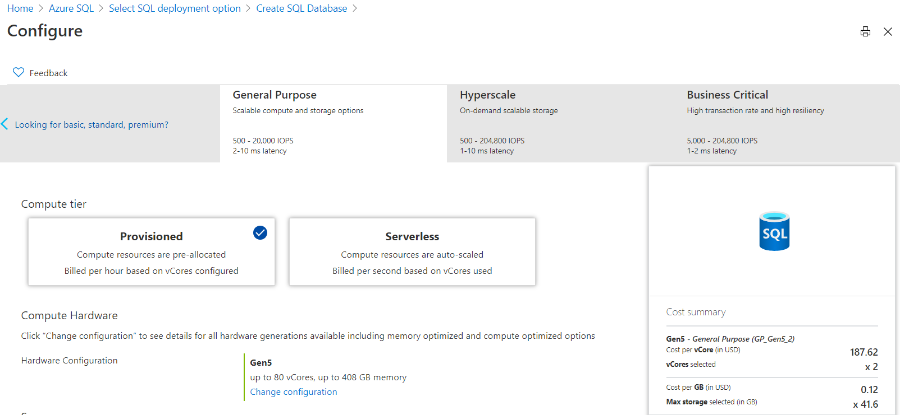
Configuration Options- Azure SQL Database
Overview
SQL Server on Azure VMs
Azure SQL MI
Azure SQL Database
Comparison and summary
Notes:
Vcore choices (up to 80 vCore is the same)
Azure SQL Database
Pick Purchasing Model
If DTU, choose Basic, Standard, or Premium
If vCore then pick Service Tier
If Service Tier is GP, then pick Compute Tier (Provisioned or Serverless) and Compute Hardware
If Hyperscale, pick Compute Hardware and number of Replicas
If BC, pick Compute Hardware, Read Scale out Enabled?, and Zone Redundant?
Azure MI
Choose Service Tier and Compute Hardware
Overview: Azure SQL Database enables you to easily purchase fully managed PaaS database engine that fits your performance and cost needs. Depending on the deployment model of Azure SQL Database, you can select the purchasing model that fits your needs:
Talking Points:
Azure SQL Database give you flexible purchasing models to have simple preconfigured compute & storage or independent control over compute & storage.
vCore model. This model allows you to independently choose compute and storage resources. It also allows you to use Azure Hybrid Benefit for SQL Server to gain cost savings.
Best for customers who value flexibility; control and transparency
Customers can select compute and storage independently
Allows customers to right-size their compute requirements in the cloud
vCore sizing offers flexibility of choice
Database Transaction Unit (DTU) model. Bundled measure of compute, storage and IO resources.
Best for customers who want simple, pre-configured resource options
Reference
https://docs.microsoft.com/en-us/azure/sql-database/sql-database-service-tiers

Slide 20
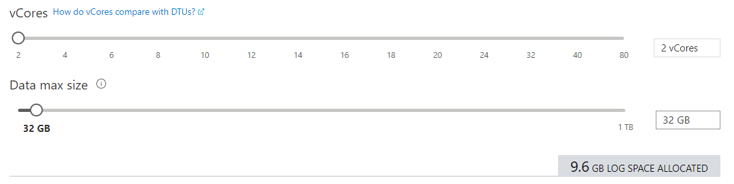
vCore Purchasing Model
Overview
SQL Server on Azure VMs
Azure SQL MI
Azure SQL Database
Comparison and summary
Notes:
Vcore choices (up to 80 vCore is the same)
Azure SQL Database
Pick Purchasing Model
If DTU, choose Basic, Standard, or Premium
If vCore then pick Service Tier
If Service Tier is GP, then pick Compute Tier (Provisioned or Serverless) and Compute Hardware
If Hyperscale, pick Compute Hardware and number of Replicas
If BC, pick Compute Hardware, Read Scale out Enabled?, and Zone Redundant?
Azure MI
Choose Service Tier and Compute Hardware
Overview: Azure SQL Database enables you to easily purchase fully managed PaaS database engine that fits your performance and cost needs. Depending on the deployment model of Azure SQL Database, you can select the purchasing model that fits your needs:
Talking Points:
Azure SQL Database give you flexible purchasing models to have simple preconfigured compute & storage or independent control over compute & storage.
vCore model. This model allows you to independently choose compute and storage resources. It also allows you to use Azure Hybrid Benefit for SQL Server to gain cost savings.
Best for customers who value flexibility; control and transparency
Customers can select compute and storage independently
Allows customers to right-size their compute requirements in the cloud
vCore sizing offers flexibility of choice
Database Transaction Unit (DTU) model. Bundled measure of compute, storage and IO resources.
Best for customers who want simple, pre-configured resource options
Reference
https://docs.microsoft.com/en-us/azure/sql-database/sql-database-service-tiers

Slide 21
Purchasing models - Azure SQL Database
DTU model
Simple, preconfigured
vCore model
Independent scalability
Compute
Compute
Microsoft’s recommendation
Storage
Storage
Pre-packaged, bundled unit that represents the database power
Designed for predictable performance, but somewhat inflexible and limited in options
DTU sizing offers simplicity of choice
Not
This model allows you to independently choose compute and storage resources. It also allows you to use Azure Hybrid Benefit for SQL Server to gain cost savings.
Best for customers who value flexibility, control and transparency
Overview
SQL Server on Azure VMs
Azure SQL MI
Azure SQL Database
Comparison and summary
Notes:
Vcore choices (up to 80 vCore is the same)
Azure SQL Database
Pick Purchasing Model
If DTU, choose Basic, Standard, or Premium
If vCore then pick Service Tier
If Service Tier is GP, then pick Compute Tier (Provisioned or Serverless) and Compute Hardware
If Hyperscale, pick Compute Hardware and number of Replicas
If BC, pick Compute Hardware, Read Scale out Enabled?, and Zone Redundant?
Azure MI
Choose Service Tier and Compute Hardware
Overview: Azure SQL Database enables you to easily purchase fully managed PaaS database engine that fits your performance and cost needs. Depending on the deployment model of Azure SQL Database, you can select the purchasing model that fits your needs:
Talking Points:
Azure SQL Database give you flexible purchasing models to have simple preconfigured compute & storage or independent control over compute & storage.
vCore model. This model allows you to independently choose compute and storage resources. It also allows you to use Azure Hybrid Benefit for SQL Server to gain cost savings.
Best for customers who value flexibility; control and transparency
Customers can select compute and storage independently
Allows customers to right-size their compute requirements in the cloud
vCore sizing offers flexibility of choice
Database Transaction Unit (DTU) model. Bundled measure of compute, storage and IO resources.
Best for customers who want simple, pre-configured resource options
Reference
https://docs.microsoft.com/en-us/azure/sql-database/sql-database-service-tiers

Slide 22
Hardware
Gen5
80 vCore limit
Up to 4 TB of local storage
Accelerated Networking is guaranteed
Future
Future hardware generations
M-series (memory optimized)
128 vCores (hyperthreaded)
3.8 TB memory
Business critical (preview)
Fsv2-series (compute optimized)
72 vCores (hyperthreaded)
3.4 GHz sustained turbo clock speed
General purpose (preview)
GEN 5
FUTURE
Overview
SQL Server on Azure VMs
Azure SQL MI
Azure SQL Database
Comparison and summary
Notes:
Consider Gen5 if …
low latency local storage is required
using more than 24 cores
workload is chatty
using more than 1 TB of local storage
Consider Gen4 if …
remote storage is used
CPU bound and need no more than 24 cores
Not available in certain regions anymore
Fsv2-series (compute optimized)
M-series (memory optimized)

Slide 23
Azure SQL Family Serverless for Azure SQL Databases
Notes:
https://github.com/microsoft/sqlworkshops-azuresqlworkshop/blob/master/azuresqlworkshop/05-Availability/basic-ha/basic-ha.ipynb
Need to have a BC and GP database deployed in order to do side by side

Slide 24
Provisioned compute cannot solve some problems
Provisioned compute with unpredictable and intermittent workloads
vCores billed
4
Provisioned compute databases are designed for predictable patterns and higher compute utilization
They struggle to meet high peaks in demand
They contribute to over-allocation of resources and costs during periods of inactivity or low usage
Lead to precious resources spent managing, not building
Unused compute resources
Compute (vCores)
2
vCores used
0
Time
Notes:
Existing offerings with provisioned compute allocate a fixed amount of compute resources for a fixed price and are billed per hour. Over short time scales, provisioned compute databases must either overprovision resources at a cost in order to accommodate peak usage or under provision and risk poor performance. Over longer time scales, provisioned compute databases can be rescaled, but this solution may require predicting usage patterns or writing custom logic to trigger rescaling operations based on a schedule or performance metrics. This adds to development and operational complexity.

Slide 25
Optimize price to performance with per-second billing
CPU usage
4
Compute resources scale dynamically up or down based on workload requirements
Configure minimum and maximum vCores to define the range of available compute capacity
Use auto-pause delay to define the time period the dataset must be inactive before pausing
Pay for compute based on the vCores and memory used per second, with lowest billing based on configured vCore minimum
Inactive
Paused
Number vCores
1
0
1:00
4:00
5:00
8:00
8:00
9:00
10:00
11:00
12:00
13:00
14:00
15:00
16:00
17:00
18:00
19:00
20:00
21:00
22:00
23:00
0:00
2:00
3:00
6:00
7:00
Min vcores
Max vcores
Vcores used
Vcores billed
Notes:
Serverless automatically scales compute for single databases based on workload demand and bills for compute used per second. In serverless, compute scaling within configurable limits is managed by the service to continuously right-size resources. Serverless also provides an option to automatically pause the database during inactive usage periods and automatically resume when activity returns. During periods of inactivity, you only pay for storage.

Slide 26
Choosing provisioned or serverless compute
More uniform resource utilization
Need for higher compute responsiveness
Scenarios where hourly billing granularity is ideal
Desire to maintain resource allocation
Interested in reserved capacity, Azure Hybrid Benefit, or elastic pools
Characteristics for provisioned compute
Price optimization will help drive the decision between provisioned and serverless compute
Large shifts in usage and periods of inactivity
Comfort with resume delay and memory reclamation
Scenarios where per second billing granularity is ideal
Desire to delegate resource allocation
Currently using single databases on General Purpose service tier
Characteristics for serverless compute
Overview
SQL Server on Azure VMs
Azure SQL MI
Azure SQL Database
Comparison and summary

Slide 27
Azure SQL Family Elastic Pools
Notes:
https://github.com/microsoft/sqlworkshops-azuresqlworkshop/blob/master/azuresqlworkshop/05-Availability/basic-ha/basic-ha.ipynb
Need to have a BC and GP database deployed in order to do side by side

Slide 28
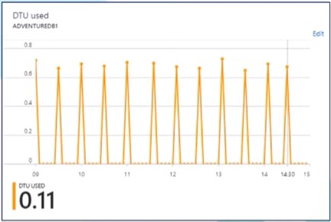
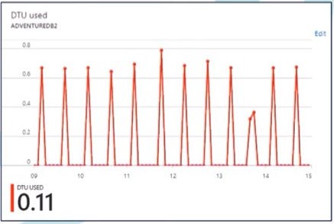
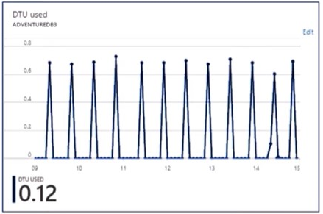
Three Singleton Databases
Singleton databases with unpredictable and intermittent usage patterns can be consolidated into a single server using elastic pools for better optimization.
Database 1
Database 2
Database 3
Overview
SQL Server on Azure VMs
Azure SQL MI
Azure SQL Database
Comparison and summary

Slide 29
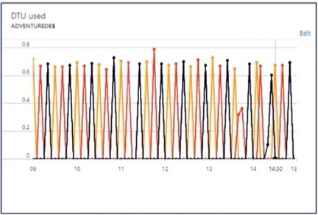
Elastic Pools
Resources combined into a single elastic pool.
Overview
SQL Server on Azure VMs
Azure SQL MI
Azure SQL Database
Comparison and summary

Slide 30
Azure SQL Family Summary
Notes:
https://github.com/microsoft/sqlworkshops-azuresqlworkshop/blob/master/azuresqlworkshop/05-Availability/basic-ha/basic-ha.ipynb
Need to have a BC and GP database deployed in order to do side by side

Slide 31
Azure SQL Managed Instance or Azure SQL Database?
Azure SQL managed instance
Azure SQL Database
Single instance
SQL Server surface area (vast majority of workloads)
Native virtual network support
Fully managed service
Instance pool
Pre-provision compute resources for migration
Enables cost-efficient migration.
Ability to host smaller instances (2Vcore)
Currently in public preview
Single database
Hyperscale storage (up to 100TB)
Serverless compute
Fully managed service
Elastic pool
Resource sharing between multiple databases to price optimize
Simplified performance management for multiple databases
Fully managed service
Overview
SQL Server on Azure VMs
Azure SQL MI
Azure SQL Database
Comparison and summary

Slide 32





How to pick Azure SQL models and service tiers
HTAP / Data Marts
OLTP
Rehosting
Rehosting and/or can tolerate 80 vCore and 100TBs
Fast provisioning and scalability
Optimize price-perf for intermittent and unpredictable workloads
Shared resource consumption for multi-tenant support
High compatibility with SQL Server and native VNET support
Migrate smaller instances to the cloud at scale
Maintain control over O/S, patching, scaling, HADR
Single database
Serverless
single database
Elastic pool
Single instance
Instance pool
SQL Server on Azure VM
Hyperscale
General purpose
Business critical
Hyperscale
General purpose
General purpose
Business critical
General purpose
Business critical
General purpose
Business critical
SQL Server on Azure VMs
100 TB
Read-scale cluster
99.99% HA
4 TB
Storage replication
99.99% HA
4 TB
Always On
99.995% HA
200 TB
Read-scale cluster
99.99% HA
4 TB
Storage replication
99.99% HA
4 TB
Storage replication
99.99% HA
8 TB
Always On
99.995% HA
8TB
Storage replication
99.99% HA
4 TB
Always On
99.995% HA
8TB
Storage replication
99.99% HA
4 TB
Always On
99.995% HA
64 disks
80K IO, 800 MBps
Overview
SQL Server on Azure VMs
Azure SQL MI
Azure SQL Database
Comparison and summary

Slide 33
Resources
Azure SQL documentation
aka.ms/azuresqldocs
Try the Azure SQL Workshop
aka.ms/sqlworkshops
Choosing the Correct Tools
aka.ms/ChooseAzureSQL
Data Exposed with Anna Hoffman
aka.ms/dataexposed
Azure SQL for Beginners
aka.ms/AzureSQL4Beginners
Notes:
@Anna

Slide 34
Additional Resources
Best Options for Database Migration into Azure: https://techcommunity.microsoft.com/t5/azure-migration/sql-server-best-options-for-database-migration-into-azure/ba-p/1497339
What is Azure SQL Database Hyperscale?: https://www.youtube.com/watch?v=Z9AFnKI7sfI
Azure SQL Elastic Pools: https://www.youtube.com/watch?v=v1Yvvo9e1gQ
Introducing Azure SQL Database Managed Instance: https://www.youtube.com/watch?v=W8feSZXm2Ec
Optimize Pricing with Azure SQL Database Serverless: https://www.youtube.com/watch?v=E23D9iXSCJQ
Notes:
@Anna

Slide 35
Summary
Azure SQL has evolved into the world’s database
Azure SQL includes Virtual machine, Managed Instance, and Database
SQL Server on Azure Virtual Machines is best for 100% lift and shift
Azure SQL Managed Instances: Database engine instance + power of PaaS
Azure SQL Database for modern cloud apps providing you the most PaaS capabilities
Overview
SQL Server on Azure VMs
Azure SQL MI
Azure SQL Database
Comparison and summary
Notes:
Anna to add

Slide 36
Thank you!

